Slide 1
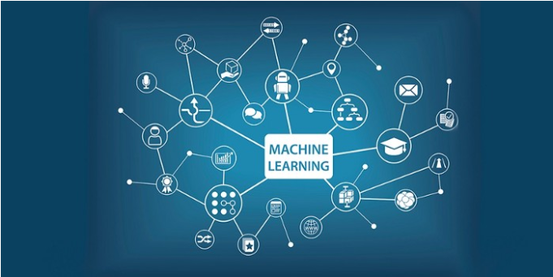
Hack-week
A look at the benefits of Machine Learning

Slide 2
Case study
The Question ... 'What is the probability of a person Within A dataset being diagnosed with diabetes?'

Slide 3
About thE data SET
"The Pima are a group of Native Americans living in Arizona. A genetic predisposition allowed this group to survive normally to a diet poor of carbohydrates for years. In the recent years, because of a sudden shift from traditional agricultural crops to processed foods, together with a decline in physical activity, made them develop the highest prevalence of type 2 diabetes and for this reason they have been subject of many studies.“
"All patients here are females at least 21 years old of Pima Indian heritage.The datasets consists of several medical predictor variables and one target variable, Outcome. Predictor variables includes the number of pregnancies the patient has had, their BMI, insulin level, age, and so on."

Slide 4
What's out there? - Software we looked at
RapidMiner – GUI for MODEL BUILDING and simulation
Tensorflow – PYTHON LIBRARY
Keras – PYTHON LIBRARY
SciKit learn – PYTHON Library
PyTorch – Python Library

Slide 5
Training a model - a high level walkthrough (rapidminer)

Slide 6
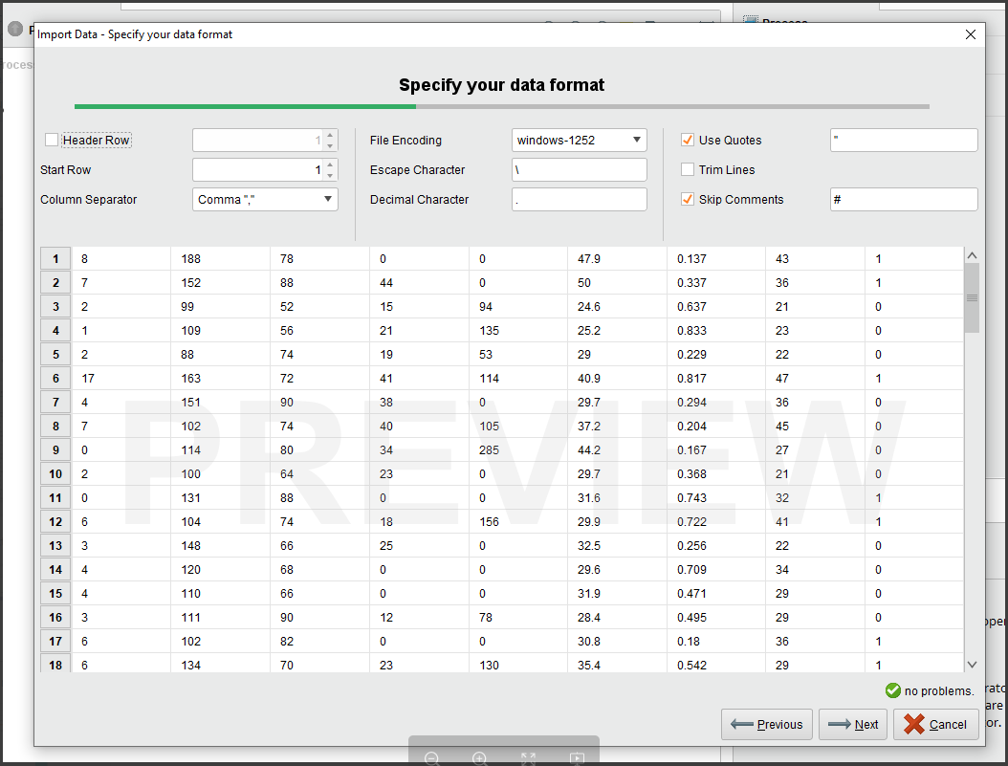
Step 1 - Import the data - and clean it.

Slide 7
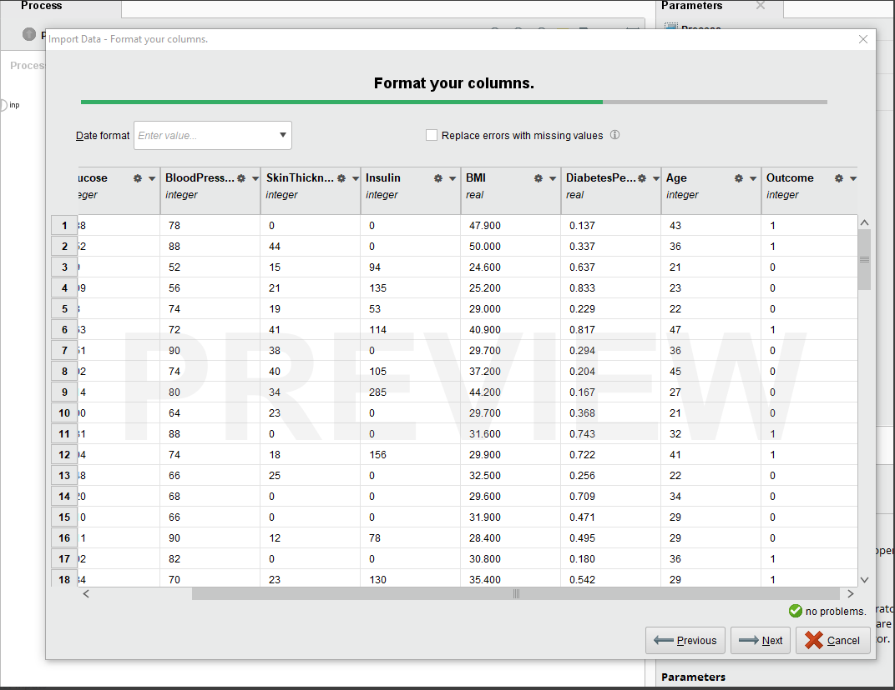
Step 2 - Format columns and store

Slide 8
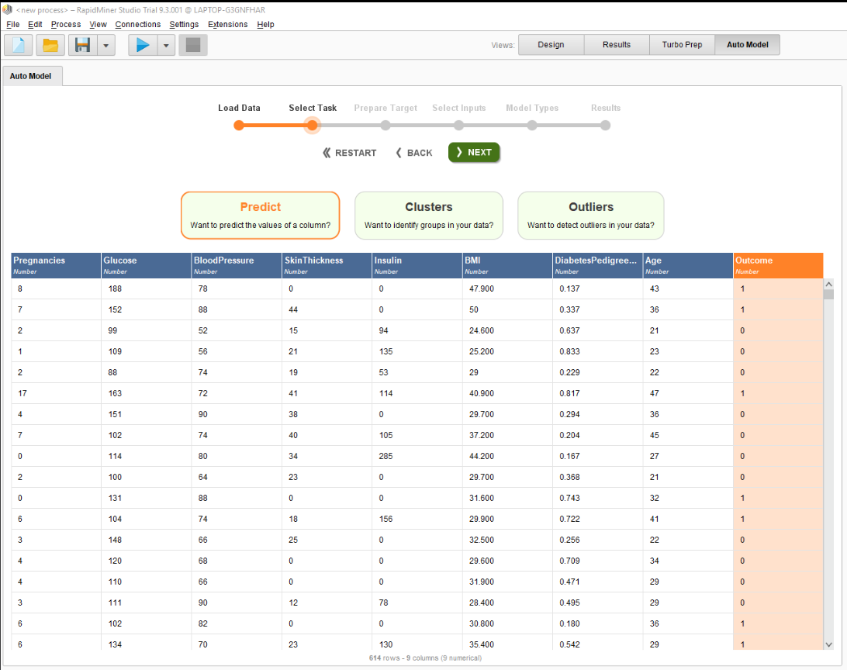
Step 3 - Select Predictability and choose column to predict

Slide 9
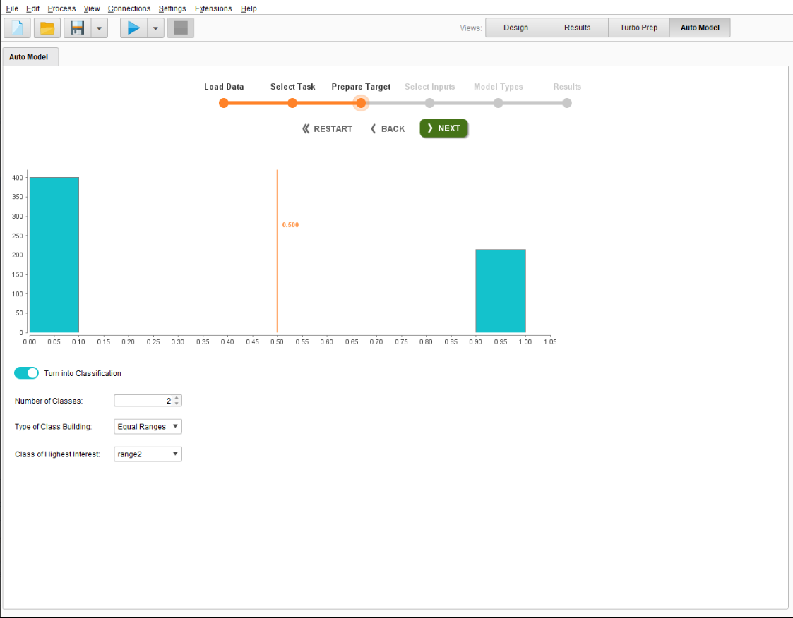
Step 4 - Prepare the target and turn on 'classification' - 2 classifications = high risk/low risk outcome

Slide 10
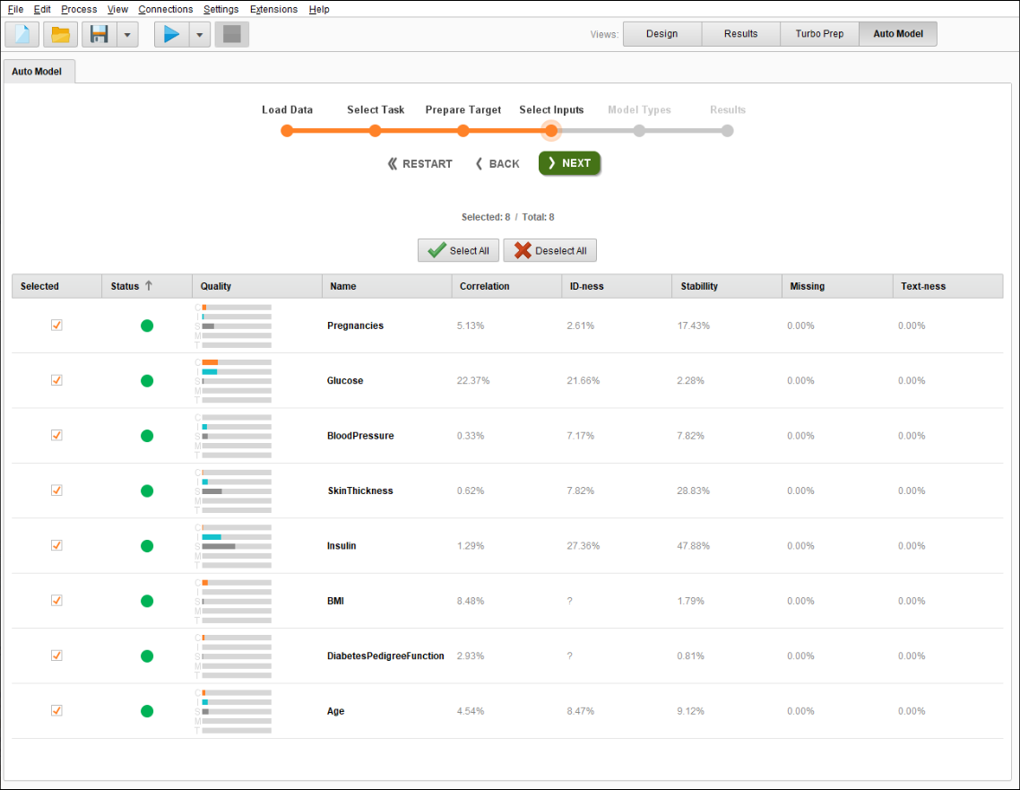
Step 5 - SELECT the inputs

Slide 11
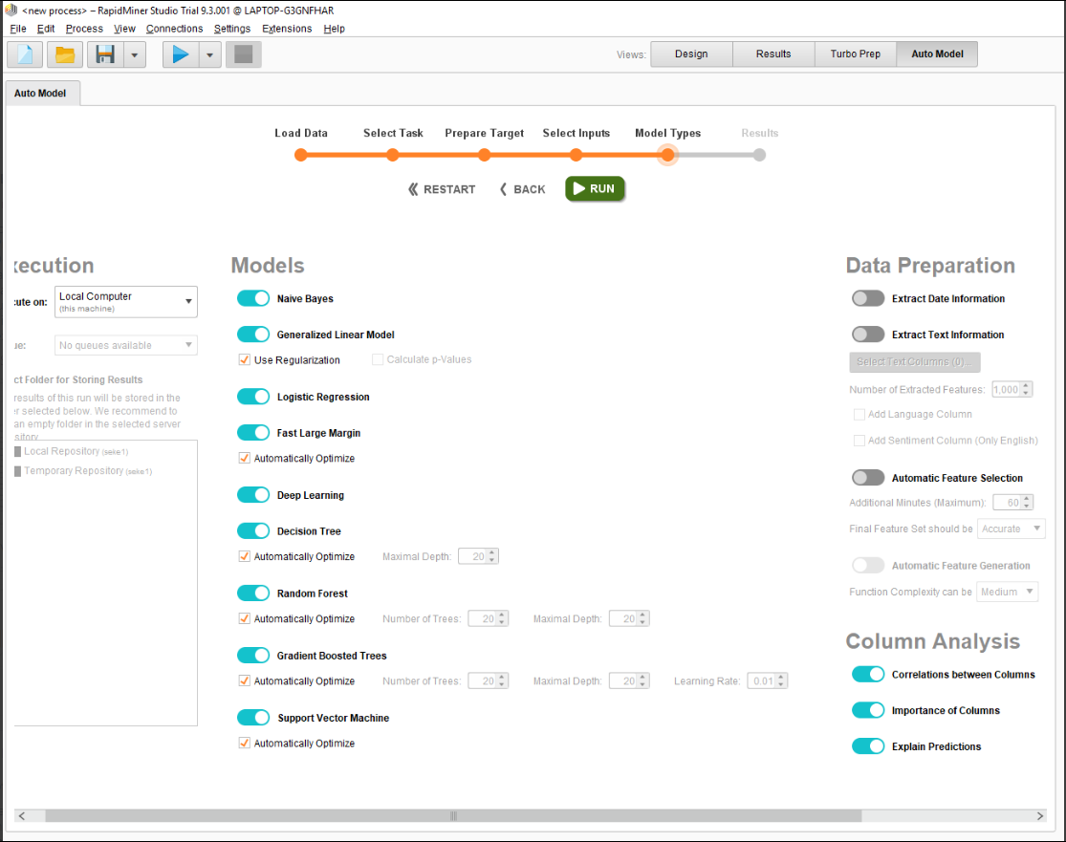
Step 6 - - Select model types and run.

Slide 12
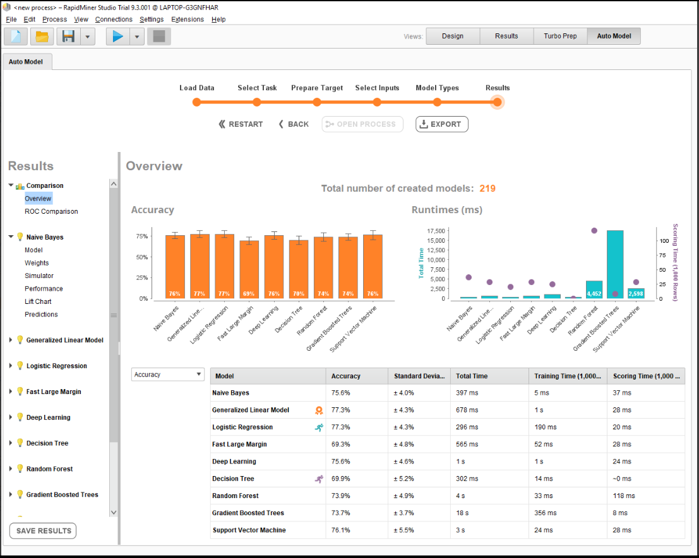
Step 7 – View high level results

Slide 13
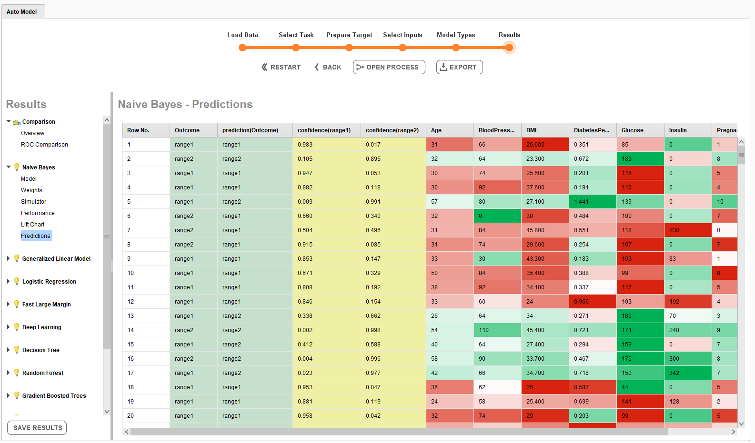
Step 8 – View prediction details

Slide 14
Points of interest
Data quality and cleanliness is very important prior to learning i.e. what to do with zero values in data sets e.g. Set the method to 'mediAN' values. Remove invalid characters, classification. This is traditionally the role of the 'data scientist'. The idea is not skew the data
The aim is to use a model which works well with the data set so that ML predictability is as accurate as possible vs real world outcomes.
There are many different algorithms that can be used
Lean towards using python libraries where possible
Resources that would be involved in ML. Analytics and statistical folk, Data Science people, Business analysts who know data sets. Technical people who shift and drop big data around the business.
ON spine, Data sources that 'inputs' can be derived from - Riak DB - Demographics, clinical and Prescribing, Splunk for logged data and Jira
The more data inputs the better resulting in a more accurate prediction.
Models are generally black box but can be visualised nicely using GUI data mining tools to see how predictions are derived(expensive though)

Slide 15

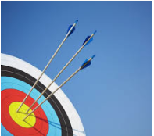
Which model won the accuracy wars
Various models with RapidMiner:-
69%-77% accuracy
Multilayer Perceptron with Tensorflow:
70%-80% accuracy
Multilayer Perceptron with Keras:
75%-80+% accuracy
DropOut MLP with Keras:
75%-80%++ accuracy
Support Vector Machine with SciKit Learn:
70%-80% accuracy

Slide 16
Potential Uses on Spine
USE baby registration data to predict birth trends and conditions
USE prescription DATA to analyse what's being prescribed and what may be prescribed in the future based on a patients medical history
predict where intermittents could occur based on patterns/occurrence that have captured in the system
ENHANCE interface design by studying the behaviour of users searching for patients via interfaces DSA, SCRa and predicting usage patterns

Slide 17
Benefits
Accurate Medical Predictions
ACCURATE MEDICAL DIAGNOSES
FINANCIAL FORECASTING
WHERE TO ALLOCATE RESOURCEs effectively around the business BASED ON PREDICTED TRENDS

Slide 18
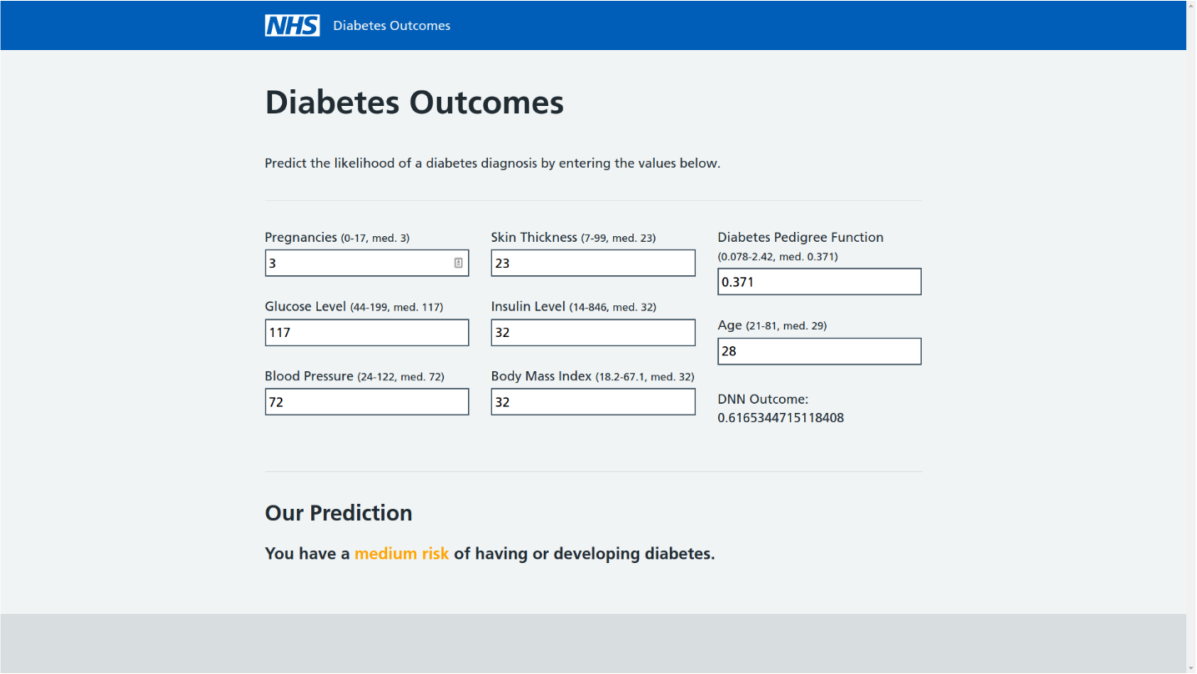
Predict outputs from given inputs using a simple API

Slide 19

Demo of the winning model

